Slide 1

Chinese IUU Fishing: A Worldwide Presence
By courtney cowper

Slide 2
Defining a Worldwide Dilema
past | present | future | recommendation
SOUTH CHINA SEA, JAPAN AND KOREA STOCK DEPLETION | IUU FISHING: DARKFLEET | TOTAL SPECIES COLLAPSE | LEGISLATION
VIOLATIONS | EEZ INVASION AGREEMENT VIOLATIONS | CONFLICT FOR RESOURCES | TECHNOLOGICAL ADVANCEMENT
AGREEMENTS SIGNED PROMISES MADE | ECONOMIC AND ECOLOGICAL DEVESTATION | IRREVERSABLE ENVIORNMENTAL DAMAGE | WORLDWIDE MONITORING

Slide 3
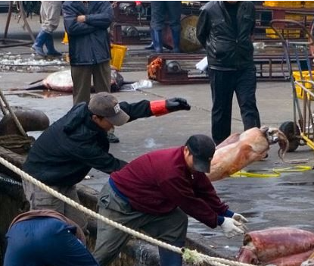
INSERT TITLE
Efficiency of modern fishing
- History of fishing culture, the cost of progress

Slide 4
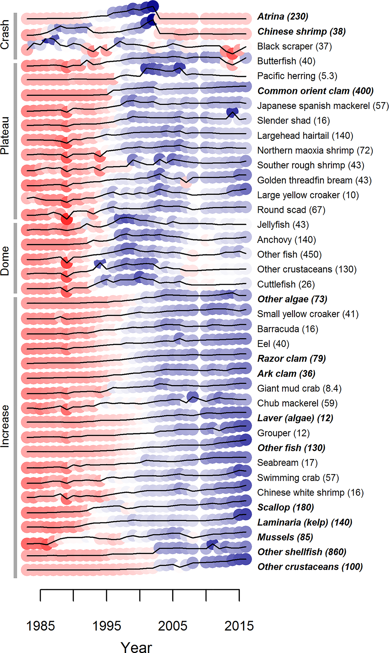
Rise of gathering over time
Most popular fishing stocks
What happened
Why theyre pursued

Slide 5
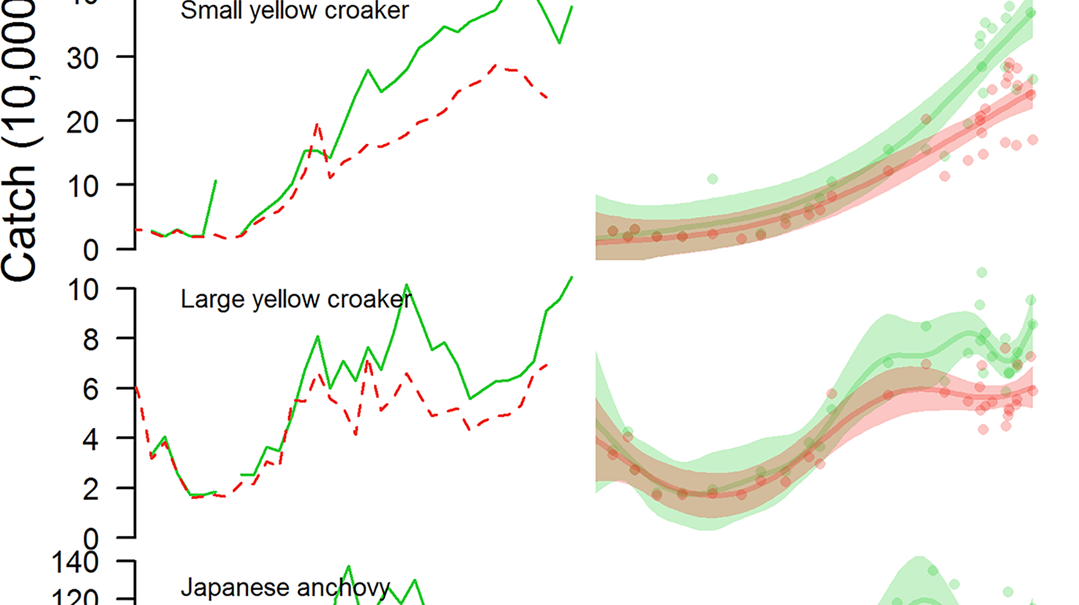
explanation
Description

Slide 6
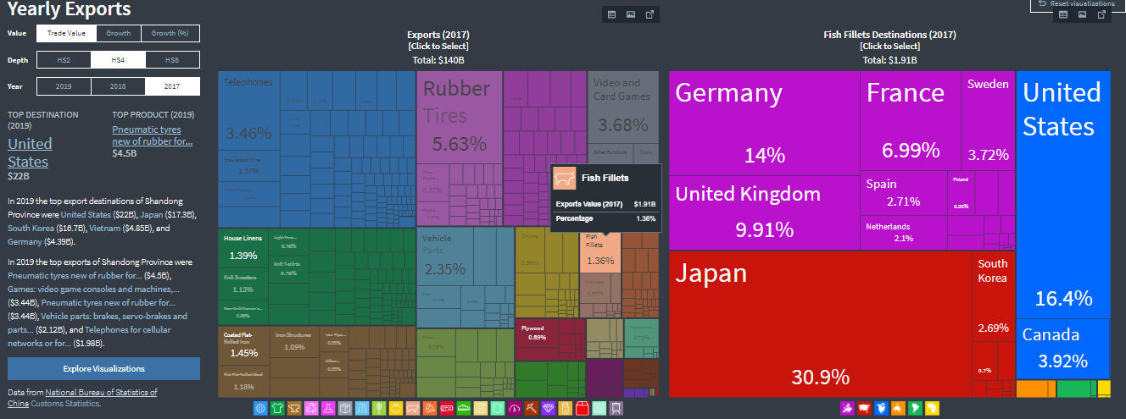
Exports
-specific numbers

Slide 7
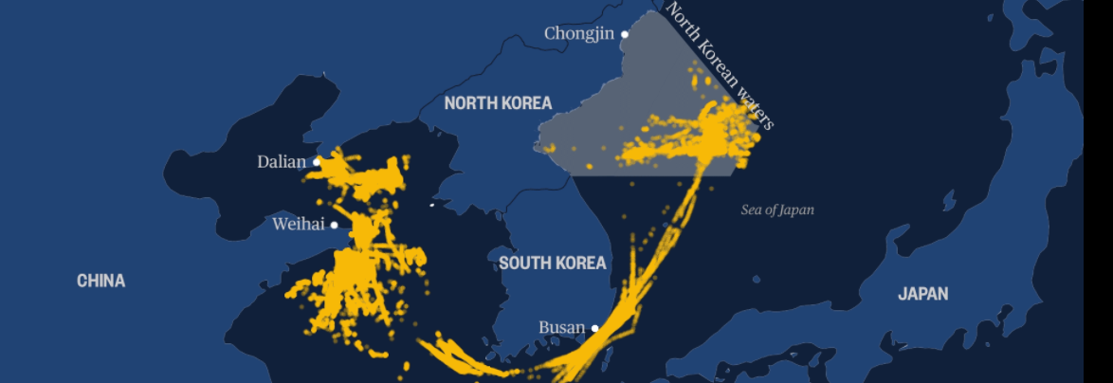
Squid fishing
Light tracking

Slide 8
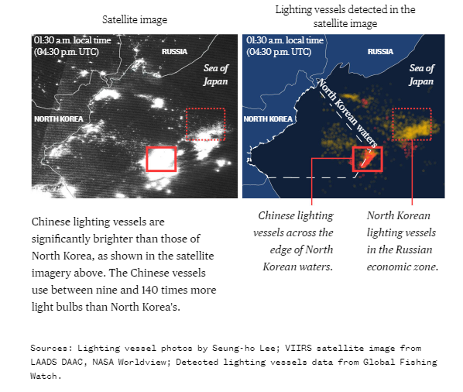
MOVEMENT
PUSHING NORTH

Slide 9
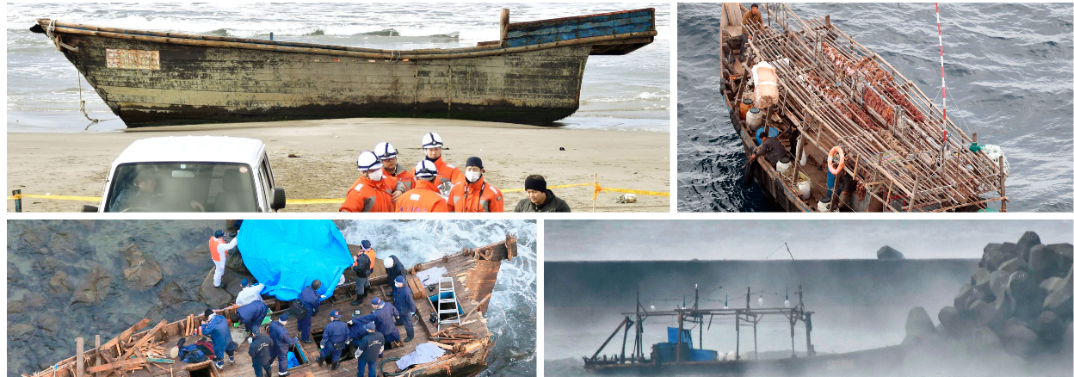
GHOST SHIPS
NORTH KOREA FISHING CRISIS

Slide 10
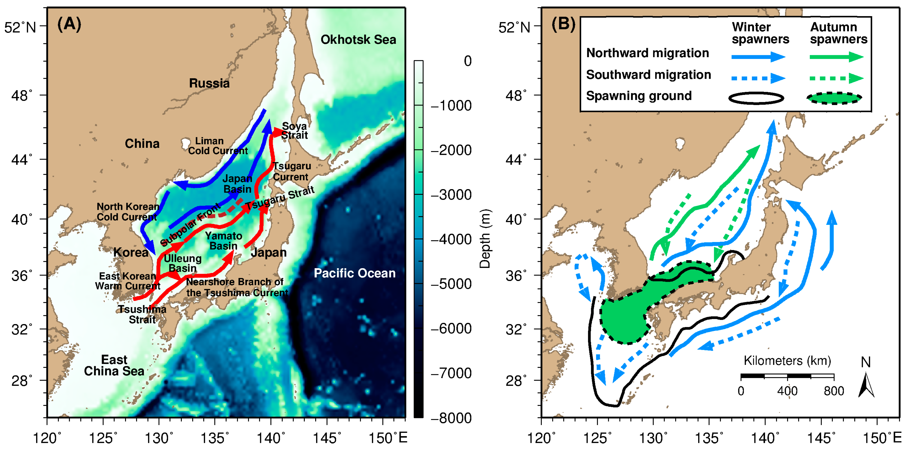
SQUID MIGRATION
50 TO 70 PERCENT OF SQUID CAUGHT IS BY CHINA

Slide 11
Migration habits expanded

Slide 12

Predictive model of next 5 years for squid populations

Slide 13

Compare contrast current policy

Slide 14
Liaoning Province | OEC - The Observatory of Economic Complexity
Shandong Province | OEC - The Observatory of Economic Complexity
Jilin Province | OEC - The Observatory of Economic Complexity
Hainan Province | OEC - The Observatory of Economic Complexity
The deadly secret of China’s illegal fishing armada: It’s killing impoverished North Korean squid fishermen (nbcnews.com)
Russia (RUS) Exports, Imports, and Trade Partners | OEC - The Observatory of Economic Complexity
Unmasking China's illegal squid fishing fleet in North Korea (digitaljournal.com)
Ocean Shock - In land of sushi, squid moves out of reach | Reuters
FAO Fisheries & Aquaculture - Country Profile
Fishing industry in Russia – Wikipedia
Marine seafood production via intense exploitation and cultivation in China: Costs, benefits, and risks (plos.org)
Exclusive economic zone of Russia – Wikipedia
China's 'Dark' Fishing Fleet Lays Waste to Global Ecosystems — Radio Free Asia (rfa.org)
How is China Feeding its Population of 1.4 Billion? | ChinaPower Project (csis.org)
China looks to big data to improve fisheries, aquaculture management (seafoodsource.com) China looks to big data to improve fisheries, aquaculture management (seafoodsource.com
Humboldt squid - Wikipedia)
Remote Sensing | Free Full-Text | Seasonal Habitat Patterns of Japanese Common Squid (Todarodes Pacificus) Inferred from Satellite-Based Species Distribution Models | HTML (mdpi.com)

